Slide 1
Bias and Variance

Slide 2
Bias
Bias is the error that calculates the difference between the average prediction of our model and the actual value that we are trying to predict.
Characteristics of a high bias model include:
Not able to capture proper data trends
Trained over noise also. So giving less accurate results
Suffers from underfitting
A more general or simple model

Slide 3
Variance
Variance is the opposite of Bias. Variance is also an error that measures the randomness of the predicted value from the actual value.
Variance errors are either the low variance or high variance.
Low variance: A model has a small variation in the predicted values with changes in the training data set.
High variance: A model has a high variation in the predicted values with changes in the training data set. A model having high variance learns everything shown to it and performs well with the training dataset, but not on test data.

Slide 4
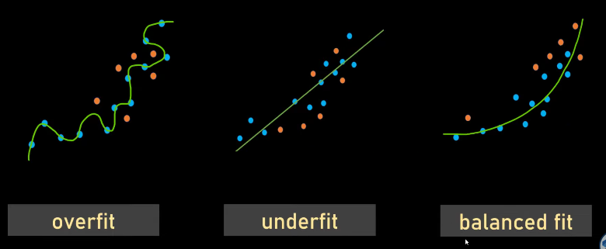
Over fit: High Variance, Under fit: High Bias, Balanced fit: Low Variance and Bias
Bias—–>Underfitting—->High train and test error
Variance—->Overfitting—–>High test error

Slide 5
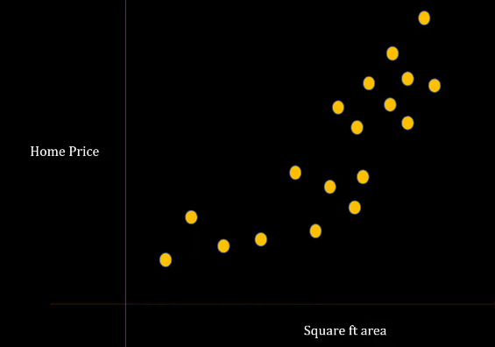

Slide 6
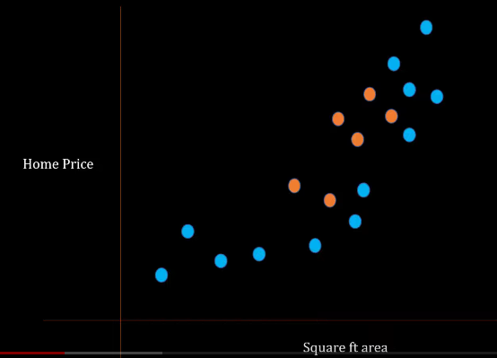

Slide 7
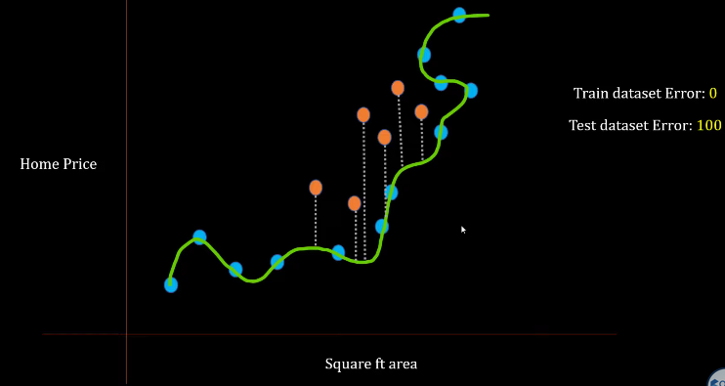

Slide 8
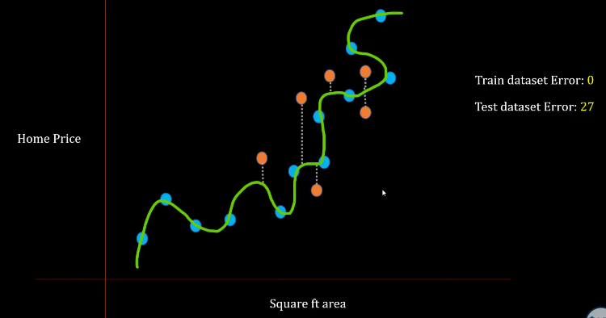

Slide 9
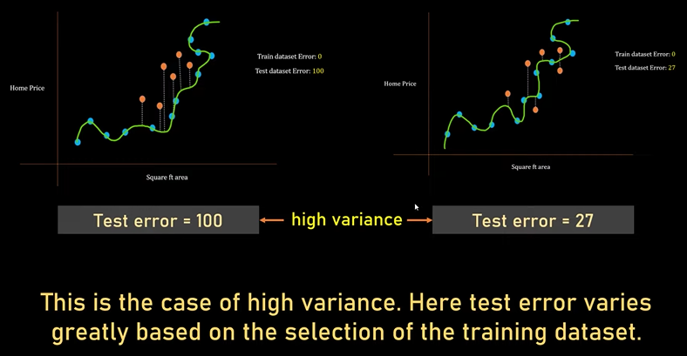

Slide 10
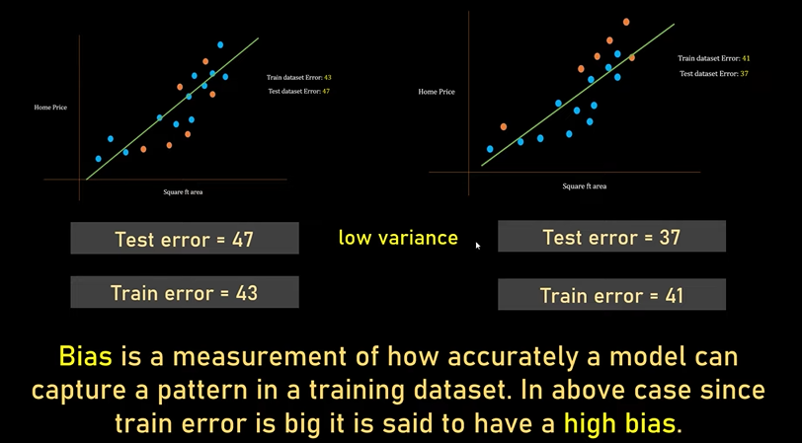

Slide 11
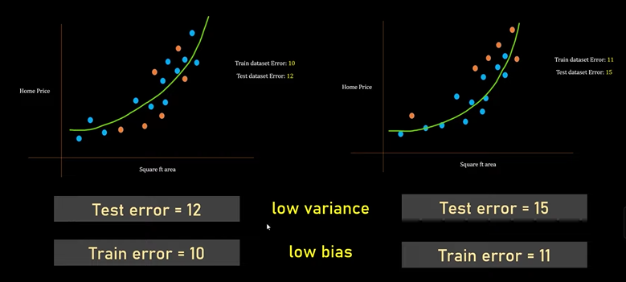

Slide 12
Low-Bias, Low-Variance: The combination is an ideal machine learning model. However, it is not possible practically.
Low-Bias, High-Variance: This is a case of overfitting where model predictions are inconsistent and accurate on average. The predicted values will be accurate(average) but will be scattered.
High-Bias, Low-Variance: This is a case of underfitting where predictions are consistent but inaccurate on average. The predicted values will be inaccurate but will be not scattered.
High-Bias, High-Variance: With high bias and high variance, predictions are inconsistent and also inaccurate on average.

Slide 13
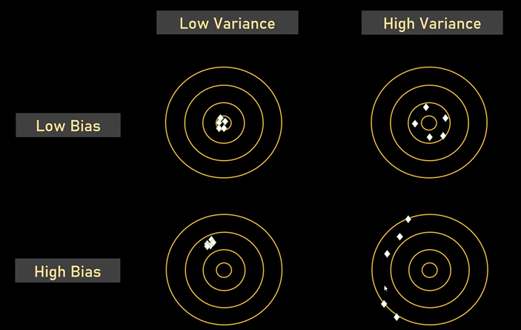
Truth value at center

Slide 14
Machine Learning Algorithm | Bias | Variance
Linear Regression | High Bias | Less Variance
Decision Tree | Low Bias | High Variance
Random Forest | Low Bias | High Variance
Bagging | Low Bias | High Variance

Slide 15
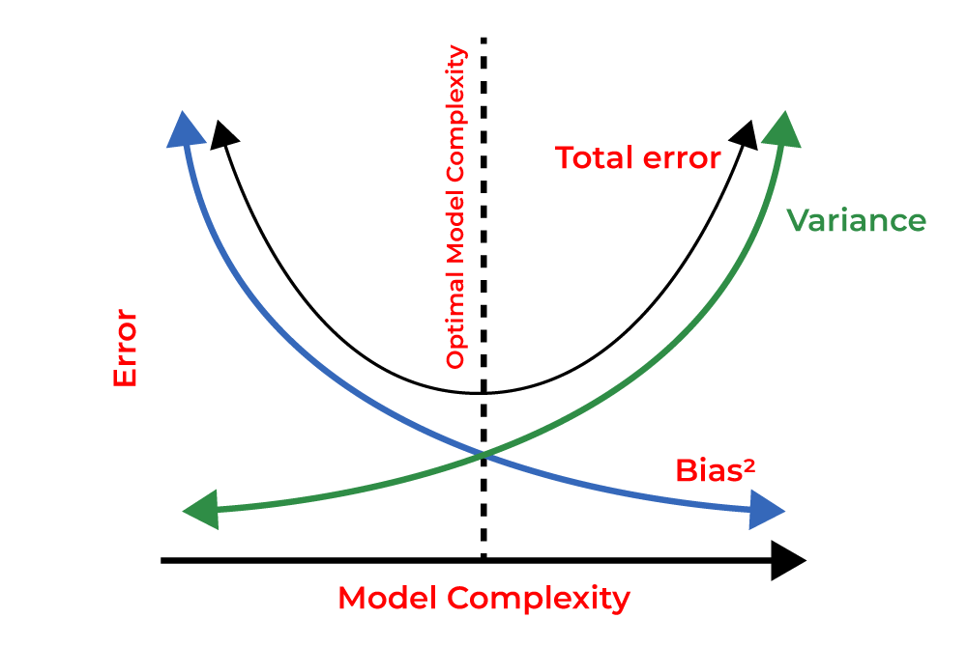
Bias-Variance Tradeoff

Slide 16
Ways to Reduce High Bias
Use a more complex model: One of the main reasons for high bias is the very simplified model. it will not be able to capture the complexity of the data. In such cases, we can make our mode more complex by increasing the number of hidden layers in the case of a deep neural network. Or we can use a more complex model like Polynomial regression for non-linear datasets, CNN for image processing, and RNN for sequence learning.
Increase the number of features: By adding more features to train the dataset will increase the complexity of the model. And improve its ability to capture the underlying patterns in the data.
Reduce Regularization of the model: Regularization techniques such as L1 or L2 regularization can help to prevent overfitting and improve the generalization ability of the model. if the model has a high bias, reducing the strength of regularization or removing it altogether can help to improve its performance.
Increase the size of the training data: Increasing the size of the training data can help to reduce bias by providing the model with more examples to learn from the dataset.

Slide 17
Ways to Reduce the Variance
Cross-validation: By splitting the data into training and testing sets multiple times, cross-validation can help identify if a model is overfitting or underfitting and can be used to tune hyperparameters to reduce variance.
Feature selection: By choosing the only relevant feature will decrease the model’s complexity. and it can reduce the variance error.
Regularization: We can use L1 or L2 regularization to reduce variance in machine learning models
Ensemble methods: It will combine multiple models to improve generalization performance. Bagging, boosting, and stacking are common ensemble methods that can help reduce variance and improve generalization performance.
Simplifying the model: Reducing the complexity of the model, such as decreasing the number of parameters or layers in a neural network, can also help reduce variance and improve generalization performance.
Early stopping: Early stopping is a technique used to prevent overfitting by stopping the training of the deep learning model when the performance on the validation set stops improving.

Slide 18
Reference
https://www.youtube.com/watch?v=B01qMFMAgUQ
https://www.shiksha.com/online-courses/articles/bias-and-variance/
https://www.geeksforgeeks.org/bias-vs-variance-in-machine-learning/

